Slide 1

Grad Conn
PROS Chief Marketing Officer
grad@pros.com

Slide 2

Notes:
Johannes Gutowski ran down the hallway, holding a manuscript

Slide 3

Notes:
480 years ago today EXACTLY

Slide 4
Notes:
Johannes Gutowski ran down the hallway, holding a manuscript

Slide 5
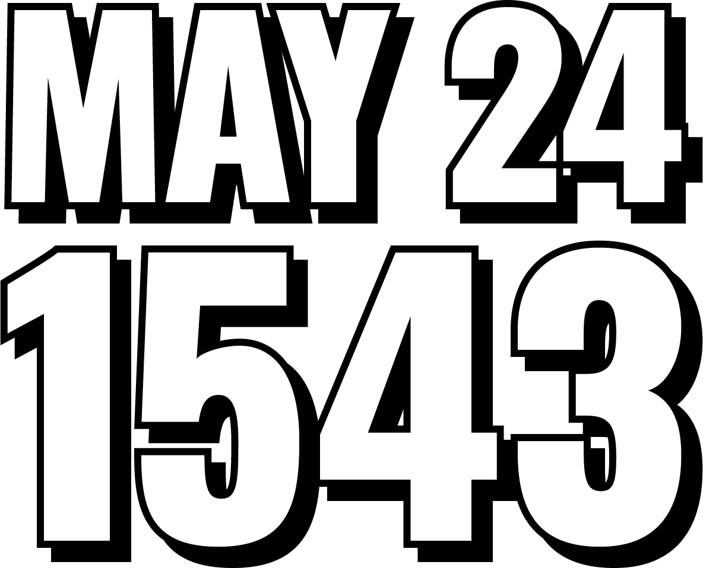
Notes:
Today, May 24, 1543

Slide 6
Notes:
Johannes Gutowski ran down the hallway, holding a manuscript

Slide 7

Notes:
In Frombork, Poland

Slide 8
Notes:
Johannes Gutowski ran down the hallway, holding a manuscript

Slide 9

Notes:
Nicolaus Copernicus died today

Slide 10

Nicolaus Copernicus (1473-1543)
Notes:
COPERNICUS was the first astronomer to formulate a scientifically-based heliocentric cosmology that displaced the Earth from the center of the universe

Slide 11

The defining epiphany that began the Scientific Revolution
Challenging “conventional wisdom”
Handed to him on his deathbed in order to avoid the penalties of heresy & The Inquisition
Notes:
The defining epiphany that began the Scientific Revolution.

Slide 12



Ptolemaic Universe
Sun
Moon
Earth
Notes:
Before that declaration, it was believed that the Earth – not the Sun – was the center of the universe.

Slide 13


Copernican Universe
Moon
Sun
Earth
Notes:
This defining epiphany, now referred to as The Copernican Shift or Copernican Revolution

Slide 14





The Copernican Shift
Ptolemaic
Copernican
Notes:
Began the Scientific Revolution and radically impacted beliefs in science, astronomy, and even religion

Slide 15
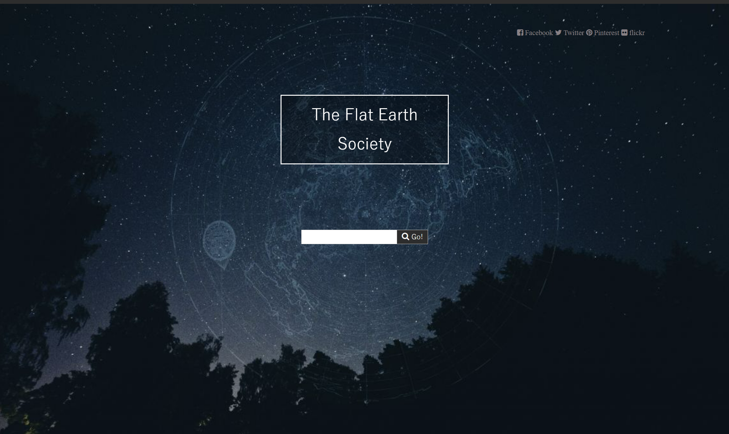
Notes:
Of course, not everyone buys in …

Slide 16

Notes:
Some still – heatedly – believe that it’s flat

Slide 17

Notes:
While more recently some freethinkers have decided it’s shaped like a donut

Slide 18

Notes:
Mmm … donuts … I’m hungry, how about you?

Slide 19
Other examples…

Slide 20




Moneyball Analytics in Sports
Notes:
Moneyball Analytics in Sports: The use of data analytics in sports, popularized by the book and movie "Moneyball," dramatically changed how players are recruited and how games are played. Teams began to use statistical analysis to gain competitive advantages, shifting away from traditional methods of player assessment.

Slide 21


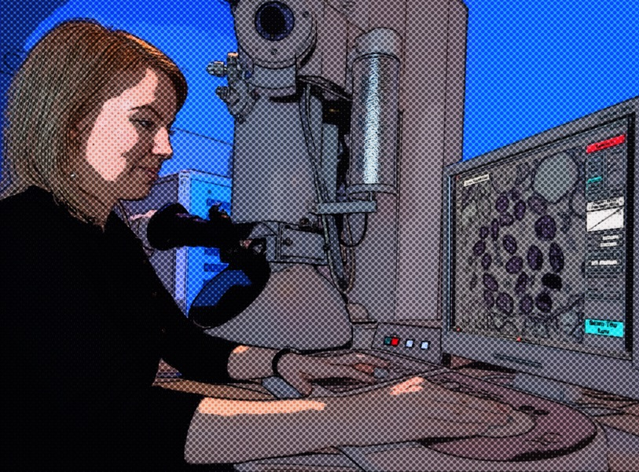

Discovery of Microorganisms
Notes:
Discovery of Microorganisms: Before the invention of the microscope, humans had no concept of the existence of organisms too small to see with the naked eye. The discovery of microorganisms drastically changed our understanding of biology, disease, and the complexity of life on Earth.

Slide 22


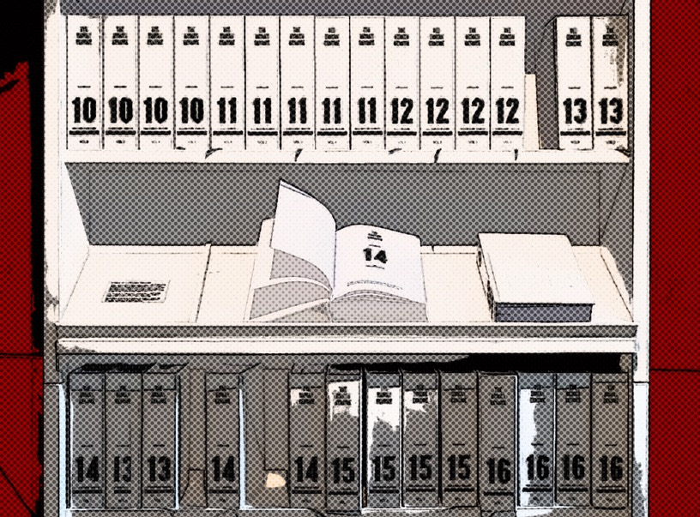

Genome Editing Technologies
Notes:
Genome Editing Technologies (like CRISPR): The ability to manipulate the genetic code of living organisms has led to a paradigm shift in biological sciences, offering unprecedented possibilities in medicine, agriculture, and synthetic biology.

Slide 23




The Cloud
Notes:
The Cloud: The shift from local, on-premise data storage and computing to cloud-based systems has drastically changed the way businesses operate, improving scalability, accessibility, and efficiency.
Each of these shifts has not only changed our understanding but also opened up new possibilities and opportunities, much like the Copernican revolution.

Slide 24
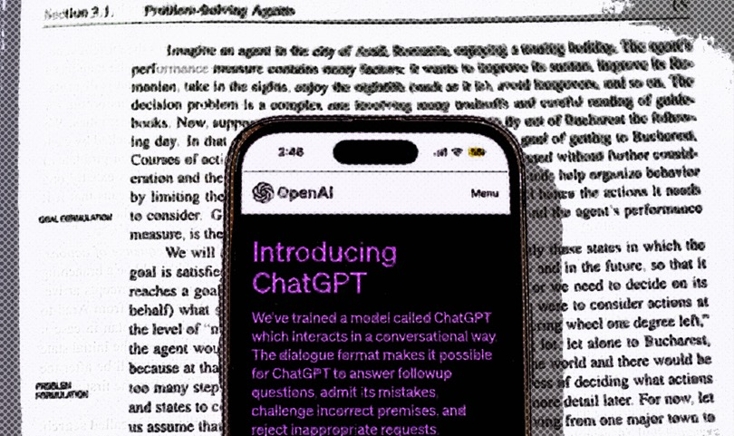



Artificial Intelligence & Machine Learning
Notes:
Artificial Intelligence (AI) and Machine Learning (ML): Traditional programming required developers to write explicit instructions for every possible scenario. But with the advent of AI and ML, computers can now learn from data and make decisions or predictions, altering the way we think about problem-solving in many fields such as healthcare, finance, transportation, and entertainment.

Slide 25

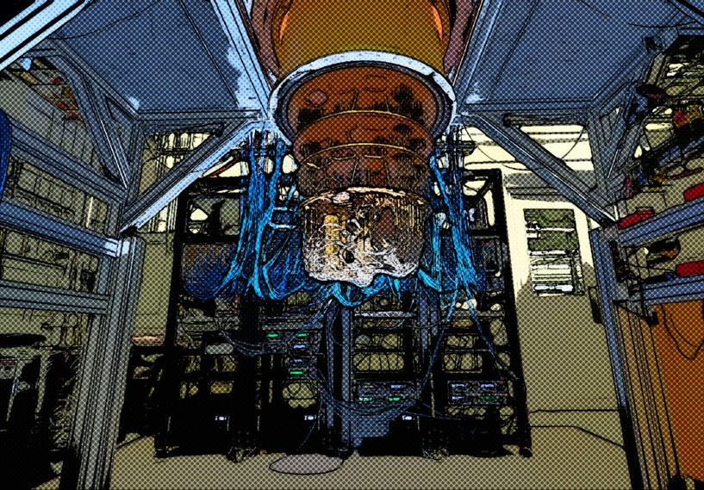


Quantum Computing
Notes:
Quantum Computing: Traditional computing is based on the binary system (bits: 0 or 1). The introduction of quantum computing and the concept of qubits, which can be in a superposition of states (0 and 1 at the same time), represent a Copernican shift. Quantum computers could potentially solve problems that are infeasible for classical computers, revolutionizing fields like cryptography, optimization, and material science.

Slide 26
The PRM Copernican Shift

Slide 27
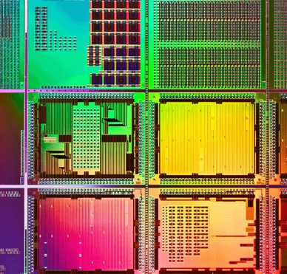











Copernican Shift
“Profit + Revenue Management (PRM)”

Slide 28
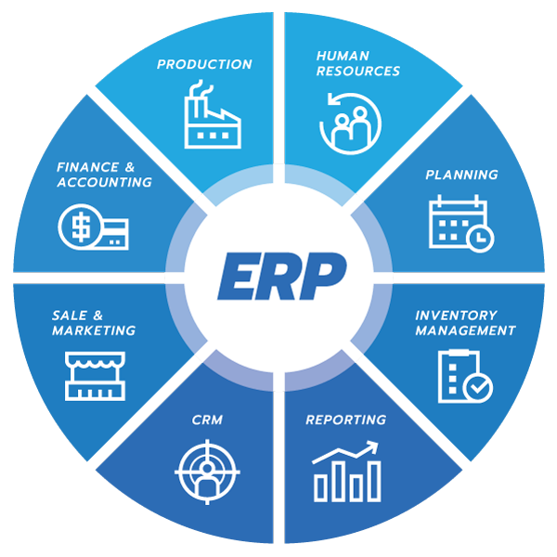

ERP
PRM
The PROS Platform

Slide 29
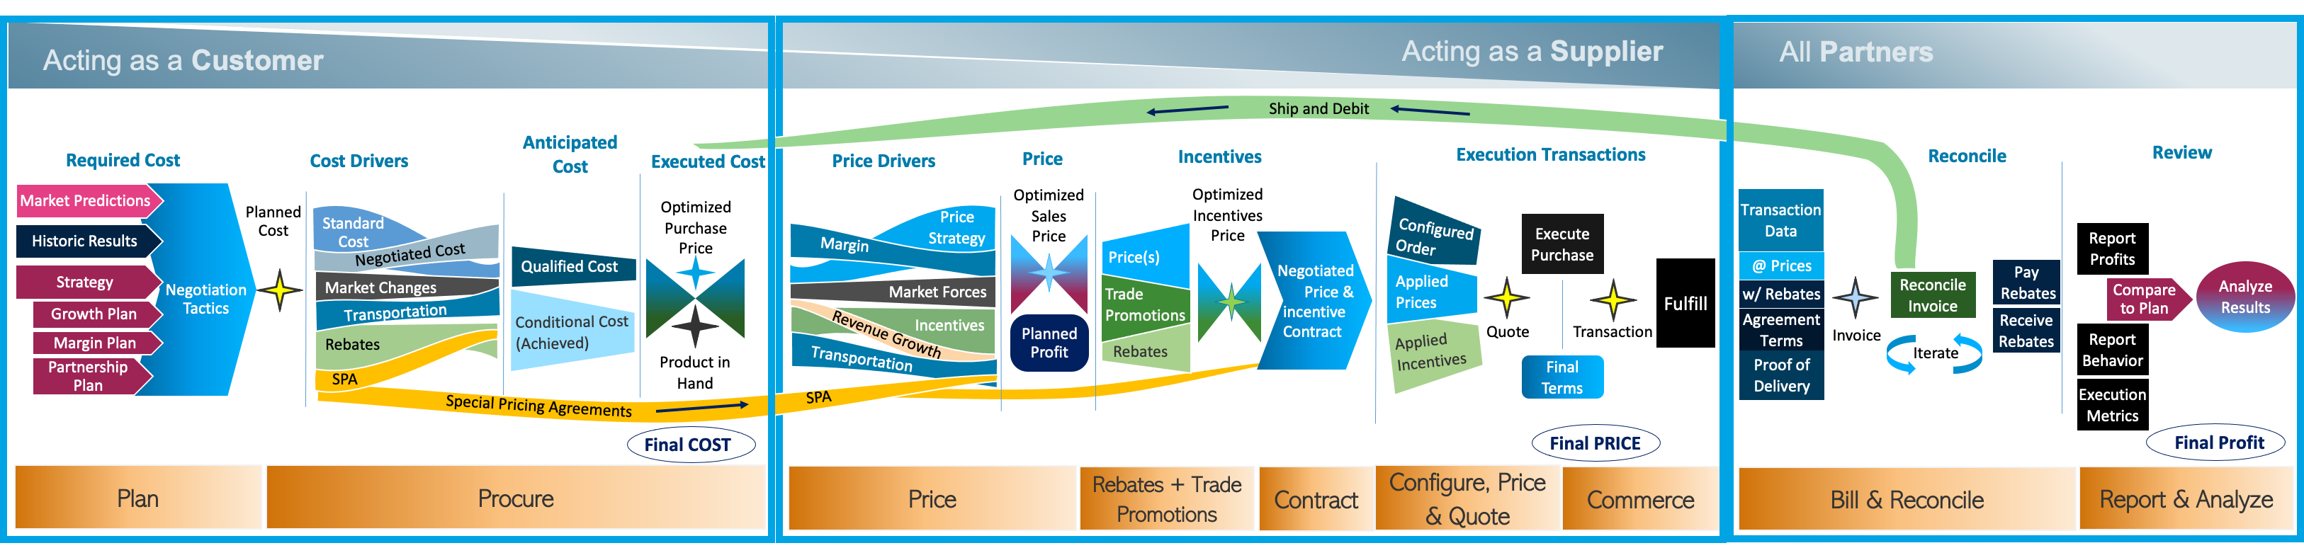
Profit + Revenue Management (PRM)

Slide 30
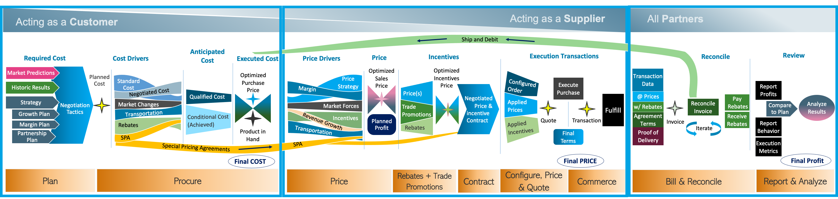
Current Pain of Manual Processes
True price & incentive profitability is difficult to calculate & visualize in spreadsheets
Disparate data, data systems of record
No holistic view of price, rebate, profit
True Net Cost and Net Sell Price are required to calculate net profit, values are masked
Rebate and Price require unified view
Cannot answer “What worked, and how can I repeat it going forward to drive further success”
The Digital Opportunity
Data available to make the right planning decisions, supporting Cost, Price and Margin
Ability to model what could work, based on what has worked
Plan
Requires accurate transaction history, past results including financials, and customer behavior
Predictions of where the marketing is going
Corporate strategy, growth
Margin & Profit plan

Slide 31
Current Pain of Manual Processes
Negotiating partners lack accurate combined Price and rebate detail to negotiate, resulting in bad facts
Mistakes, BIG Mistakes are made
Lack of holistic view
Difficult to rationalize & Optimize across vendors / geos
Cannot answer: What is the right purchase price, maximizing my rebates?
The Digital Opportunity
Category or deal profitability presented, with Price and Incentive (Rebates) included
Ability to ”what if” optimize
AI guidance
Holistic View
Establish mutually beneficial contracts
Procurement negotiations
Harmonization of goals between trading partners, for mutual growth
Products, Volumes, Markets, competitors
Prices
Incentives

Slide 32
PRM
Price & Incentive Optimization
Determining optimal price + incentive to drive profitable trade with partners.
contract price,
special bid or quote,
“what if” analysis of annual sales including Products, Volumes Markets, Prices, Incentives
The Digital Opportunity
“This is the right price for your product”
Holistic price, incentive & profit approach
Optimized price and incentives, drive right behavior outcome
Visualization, in real time, of current costs and incentives affecting profit & behavior
Designs pricing and incentive scheme for basic contract prices as well as negotiated exception contracts
Current Pain of Manual Processes
Lack of holistic view of all profit influencers
Price optimization ≠ optimization of Profit when incentives are negotiated separately
Optimization of profit on partial data
Different Operational / Management Silos (Product, Pricing, Sales, Finance), with different metrics
Cannot answer: What is the right price and rebate to get my trading partner to act today and in the future?

Slide 33
PRM
Price, Optimization, and Contract
Calculator to get to a configured price quotation for: special bid, complex bill of materials, new contract price, multiple year negotiation or anu sales quote requiring “what if” analysis, then execute in a Commerce Platform
Products & dependent products
Volumes, volume breaks, markets, competitors
Prices & growth incentives, to close Buy Now
“The Ultra Bro Deal”
Current Pain
Configuration is slow and complicated,
Mis-configured products, mis-quoted prices
Quotation can take days
Lost deals = lost revenue
Seller disconnected from product or pricing teams
Lack of holistic, real time, deal specific view of profit, combining net price and net rebates, or potentially unattained rebates
Could I have negotiated a better deal or outcome?
The Digital Opportunity
The right price and incentive are presented to close the deal today
Values optimized to behavior outcome
All metrics are presented to seller to make the right decision
Quote feeds commerce engine for flawless execution
Addresses all uses of CPQ for “What if”

Slide 34
PRM
Billing and Reconciliation
Transaction data provides empirical proof of price, rebate, customer, location, and contract terms & conditions between relevant trading partners.
With Transaction data in hand, invoices are generated with appropriate rebates deducted
Reconciliation process is straightforward when
Current Pain of Manual Processes
High number of exceptions
High number of iterations to resolution
Multiple rebates assigned to single invoice, different rules apply, hidden in agreements
Delayed payment or receipts of funds, can cause mis-statement of financials
Visibility of rebate impact to cashflow is limited
Cannot answer: What is the cost to my business for all the iterations and conflicts?
The Digital Opportunity
Single source of clean data
Clear link between transaction, agreement, price and rebate at point of sale, linking to invoice
Visibility between trading partners (everyone sees the same data)
Reduced exception and iterations

Slide 35
PRM
Ship and Debit
Special Pricing Agreements
Special Pricing Agreements
Deviated Pricing, Ship and Debits, Special Terms, Contract pricing, POD Invoicing, Claim Backs
Modifier of Price to Distributor and Customer
Modifier of Margin to MFG, Distributor, Customer
Managed as a payment in arears via invoice debiting or rebate payment
Customer gets a special deal from the manufacturer;
Distributor must track, deliver and invoice, correctly.
Current Pain of Manual Processes
Oooh, what a mess . . . Reflects reality
Complex, mistake-prone process
Multiple iterations to resolve
3-way profit optimization is not happening
Distributor is disintermediated
Can create market disparity
Rarely a true win win between trading partners
Cannot Answer: Could I achieve same results without deviating from a standard contract?
The Digital Opportunity
Holistic price and rebate approach across all three trading partners, driving intended results
Integrated reconciliation connecting shipments, receipts, prices & rebates directly into accounting (AP/AR) systems
Clear status on state of payments
Reduced iterations

Slide 36
PRM
Report and Analyze
Strategic, operational and financial performance reporting
Critical measurement for:
“How are we doing?”
“Did we achieve the indented results?”
“Did the behavior we intended occur, with the pricing and incentives we positioned with our trading partners
”What levers & magnitudes gave us the best result?
What if . . . ?
Current Pain of Manual Processes
Siloed data & reporting in siloed departments
Difficult to declare success
Difficult to understand root cause of success or failure
Lack of connection from previous timeframe (Behavior result) to enable future strategic results (desired behavior)
Cannot Answer:
The Digital Opportunity
Unified view of outcome to plan, supported by relationship between the levers that promote change and the results they delivered
What is the right price and right incentive for me to profitably buy and sell my products, while driving growth for myself and my trading partners?

Slide 37

Raw material supplier

Slide 38

A factory wants to buy your raw materials

Slide 39
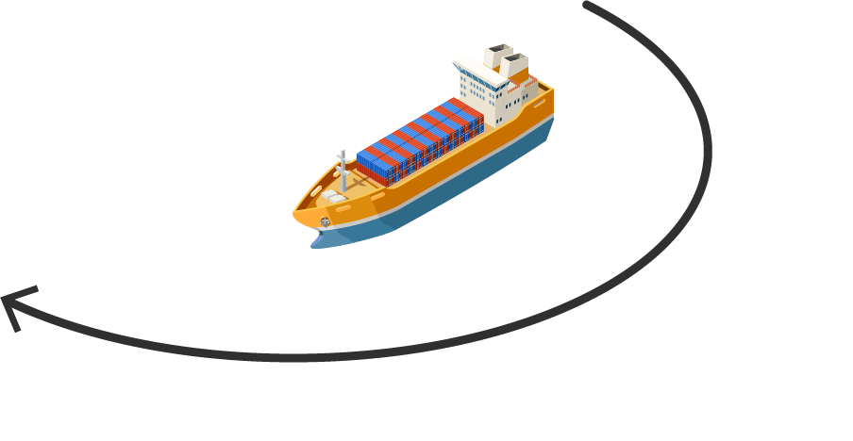
So, you sell your raw materials to the factory
Simple, right?

Slide 40

HOLD ON A SECOND!

Slide 41

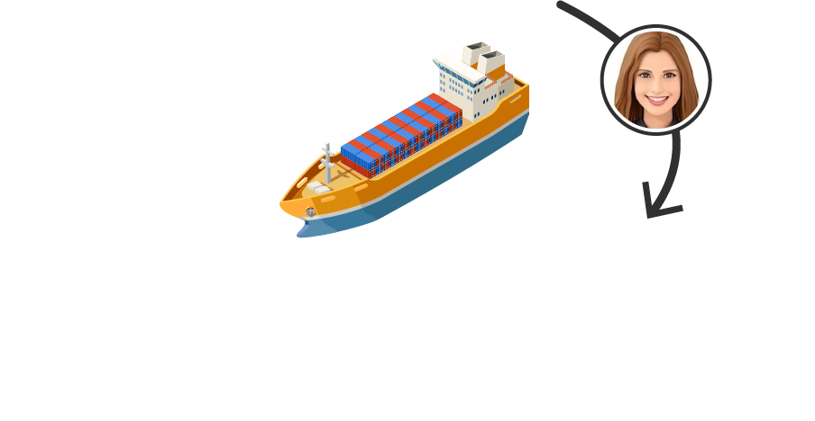
STEP 1: Determine the Sale Price
What is the sale price of your raw materials today?

Slide 42
STEP 1: Determine the Sale Price
What is the sale price of your raw materials today?
What will the market value of my raw materials be tomorrow?
To what level will they need it refined?
What rebates will be necessary?
Will I need to find more exotic sources of raw material to meet demand?
Do I need to warehouse it?
How will I get the raw materials from the mine to my customers?
How much does it cost to mine it?

Slide 43

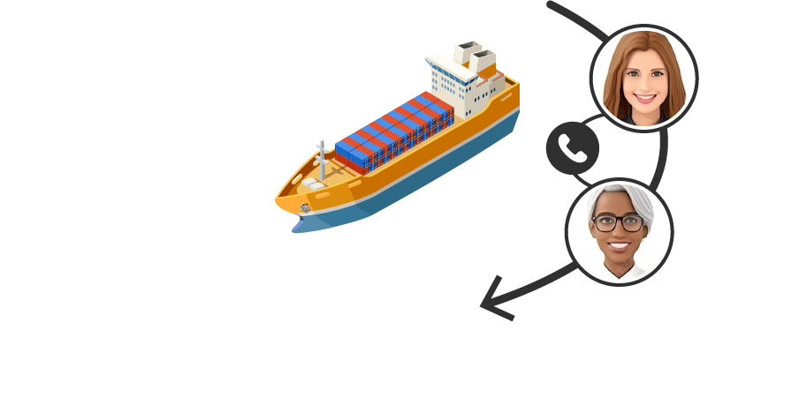
STEP 2: Structure the Deal
What products does the customer require?
YARR!!

Slide 44
STEP 2: Structure the Deal
How will I know if my deal is a good deal for the business?
What marketing co-op dollars are you willing to provide?
What products does the customer require?
How can you find the right product out of millions of SKUs?
What is my “walk-away” price for the deal?
What is the price for exclusivity?
What are all the relevant related products the customer might be interested in?
What do I do if my customers prefer subscribing to my products?
What are business targets we need to meet to receive the best net cost?
How do I know my product information is current and accurate?
What pricing tiers can you offer me if I buy more?
OK, But what is the “ultra-deal”. I mean we have been doing business together for years and I am not going to take this new price…
How will I know if the options I’ve selected are even compatible with one another?
If you want me to expand my market, are you willing to give me rebate incentive to cover the additional costs?

Slide 45
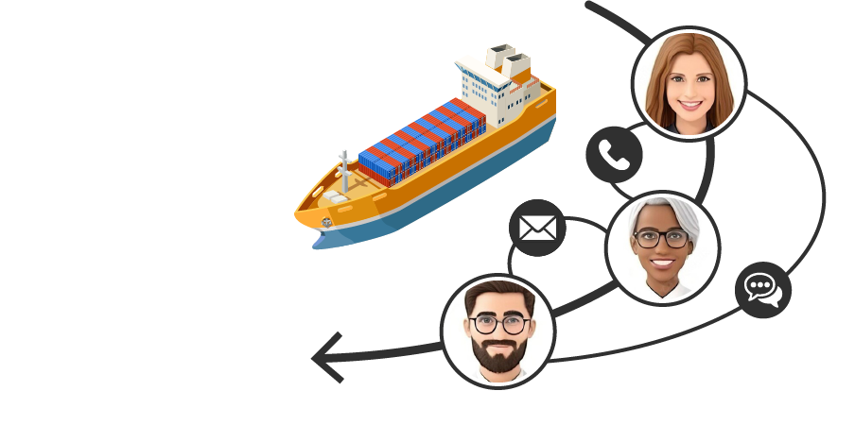

STEP 3: Complete the Transaction
Add items and check out.
SHARKS!

Slide 46
STEP 3: Complete the Transaction
Add items and check out.
How will my salespeople get quotes to our customers?
What do we do if our customers don’t want to work with a salesperson?
And what about Amazon? Do they sell for me? Do I sell to them?
How can I ensure the right commercial strategies exist on our eCommerce site?

Slide 47

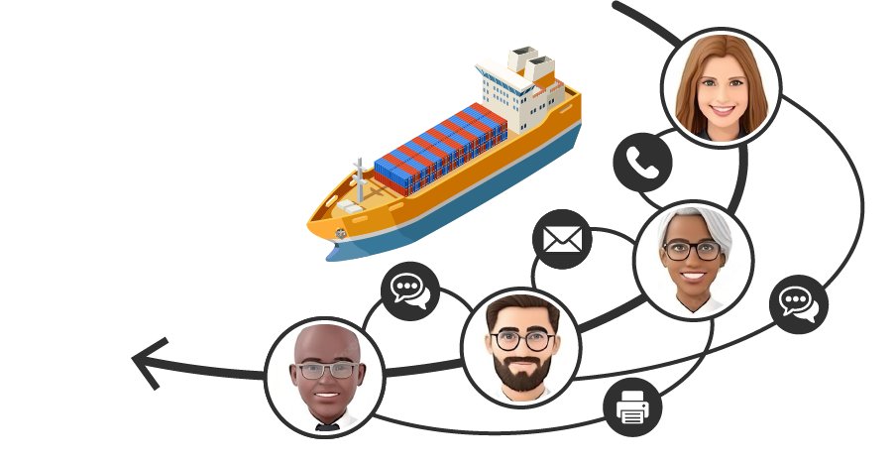
STEP 4: Fulfill the Order
Pick. Pack. Ship.

Slide 48
STEP 4: Fulfill the Order
Pick. Pack. Ship.
What warehouse should the products ship from?
How do I initiate a service contract for a new subscription?
Can I reduce costs by organizing shipments differently?

Slide 49
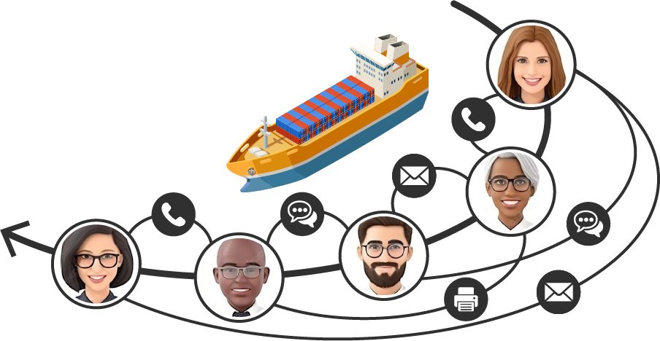

STEP 5: Reconcile the Books
Calculate your revenue and margins.
KRAKEN!!!

Slide 50
STEP 5: Reconcile the Books
Calculate your revenue and margins.
How do I make sure the invoice is right when the same product and customer receive a deviated price by location?
How can I earn more share of wallet?
How do I claim my rebates?
How do ensure my customers remain loyal?
How do I know I met the requirements of my rebate program?
How do I know if I am ultimately running a growing, profitable business?
Where are my rebate discounts not shown on this invoice?

Slide 51
ALL: Massive Complexity
How will I know if my deal is a good deal for the business?
How will my salespeople get quotes to our customers?
What marketing co-op dollars are you willing to provide?
How can you find the right product out of millions of SKUs?
How do I make sure the invoice is right when the same product and customer receive a deviated price by location?
What is my “walk-away” price for the deal?
How much does it cost to mine it?
What do we do if our customers don’t want to work with a salesperson?
What warehouse should the products ship from?
What is the price for exclusivity?
What will the market value of my raw materials be tomorrow?
What are all the relevant related products the customer might be interested in?
How can I earn more share of wallet?
To what level will they need it refined?
What do I do if my customers prefer subscribing to my products?
How do I claim my rebates?
What are business targets we need to meet to receive the best net cost?
And what about Amazon? Do they sell for me? Do I sell to them?
How do I initiate a service contract for a new subscription?
How do ensure my customers remain loyal?
Will I need to find more exotic sources of raw material to meet demand?
What rebates will be necessary?
How do I know my product information is current and accurate?
How do I know I met the requirements of my rebate program?
What pricing tiers can you offer me if I buy more?
How can I ensure the right commercial strategies exist on our eCommerce site?
Can I reduce costs by organizing shipments differently?
OK, But what is the “ultra-deal”. I mean we have been doing business together for years and I am not going to take this new price…
How do I know if I am ultimately running a growing, profitable business?
Do I need to warehouse it?
How will I get the raw materials from the mine to my customers?
How will I know if the options I’ve selected are even compatible with one another?
If you want me to expand my market, are you willing to give me rebate incentive to cover the additional costs?
Where are my rebate discounts not shown on this invoice?
Notes:
When your job feels hard it’s because it is – especially if you’re doing all this stuff manually

Slide 52

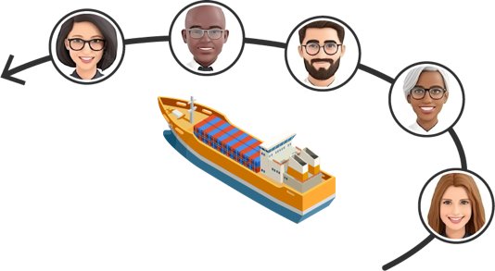

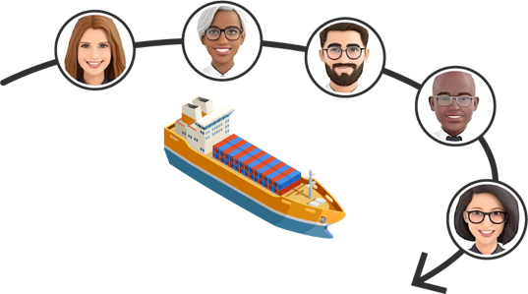

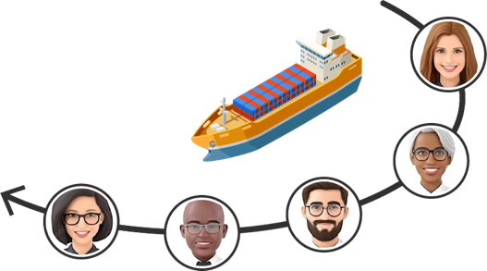
We live in a multi-customer, omnichannel world…

Slide 53

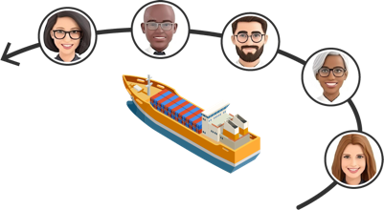






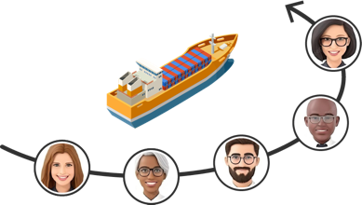
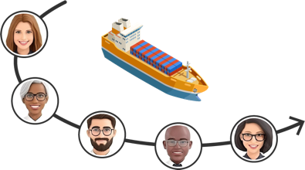
… with multiple supplier-customer relationships
Notes:
Any more and my designer would kill me

Slide 54
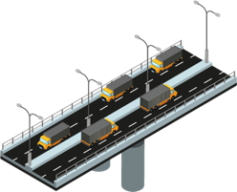
The PROS Platform
Digitize, automate, and leverage AI to Optimize

Slide 55









The PROS Platform
CRM
ERP
ECP
PRM
HCM
PSS
GDS
Notes:
Because of its function as a prediction and optimization system, PROS lives in a broader ecosystem of platforms with which it connects
Today, the PROS platform stands at the center of a vast ecosystem comprising CRMs, ERPs, billing systems, HCMs, payroll, and accounting systems, among others. This interconnected ecosystem provides businesses with a holistic view of their operations and aids in efficient, data-driven decision-making.
The engineers behind PROS continue to work on enhancing its capabilities and integrating it with emerging technologies. The future of PROS is geared towards creating an even more comprehensive, interconnected ecosystem that leverages the latest technological advancements to drive business productivity and profitability.
PR ediction &
O ptimization
S ystem

Slide 56











CRM
ERP
The PROS Platform
ECP
PRM
HCM
PSS
GDS
Notes:
API integration into any ecosystem

Slide 57


CRM
ERP
OTA
The PROS Platform
PRM
Extract
Transform
Load
HCM
PSS
GDS
Notes:
PROS Integrate uses ETL connectors are designed to work with a multitude of data types and formats. They can efficiently extract data from various structured and unstructured sources, such as relational databases, NoSQL databases, APIs, and flat files.

Slide 58




transactions per minute
uptime
Platform
annual transactions
NYSE volume

Slide 59

Level 1
PROS Integrate
APIs:
Seamlessly integrate with existing CRM, ERP, eCommerce, GDS, PSS, HCM, CX, and MarTech stacks with real-time low-code and no-code reconfiguration
1. PROS Integrate
Notes:
Once the data is extracted, the ETL connectors carry out a series of transformations to ensure compatibility with the PROS platform. These transformations may include data cleaning, deduplication, validation, and standardization.
The connectors can also perform complex transformations, such as aggregations, pivoting, and data type conversions, to ensure that the data fits the analytical requirements of the PROS platform.

Slide 60
Level 1
PROS Integrate
ETL Connectors:
Efficiently extract data from structured and unstructured sources, such as relational databases, NoSQL databases, APIs, and flat files
1. PROS Integrate
Notes:
Once the data is extracted, the ETL connectors carry out a series of transformations to ensure compatibility with the PROS platform. These transformations may include data cleaning, deduplication, validation, and standardization.
The connectors can also perform complex transformations, such as aggregations, pivoting, and data type conversions, to ensure that the data fits the analytical requirements of the PROS platform.

Slide 61


Level 2
PROS Resilience
System Resilience:
Extreme scalability, high reliability, internal observability, high performance and efficiency, and near 100% availability with full redundancy
2. PROS Resilience
1. PROS Integrate

Slide 62


Level 3
PROS Datacore
Common Datacore:
Unified prediction + optimization data model which works across multiple data types and industries
3. PROS Datacore
2. PROS Resilience
1. PROS Integrate

Slide 63


Level 4
PROS Protect
Governance:
Role-based access control, auditing & tracking changes, reporting to enable managers to track operations and ensure accountability
4. PROS Protect
3. PROS Datacore
2. PROS Resilience
1. PROS Integrate

Slide 64
Level 4
PROS Protect
Security:
Multi-layered defense in depth, encryption at rest and in transit, enables users to manage use provisioning and authentication, including Multi-factor Auth
4. PROS Protect
3. PROS Datacore
2. PROS Resilience
1. PROS Integrate

Slide 65
Level 4
PROS Protect
Privacy:
Fully compliant with General Data Protection Regulation (GDPR) and the California Privacy Rights Act (CPRA), including consent management functionality
4. PROS Protect
3. PROS Datacore
2. PROS Resilience
1. PROS Integrate

Slide 66
Level 4
PROS Protect
Compliance:
Supports industry-specific compliance standards and provides comprehensive reporting tools to assist in audit trails and evidence for compliance checks
4. PROS Protect
3. PROS Datacore
2. PROS Resilience
1. PROS Integrate

Slide 67


Level 5
PROS Predict
Prediction:
Multiple types of AI technologies analyze your data to make predictions — algorithms can be chained to increase accuracy and are extensible by customers
5. PROS Predict
4. PROS Protect
3. PROS Datacore
2. PROS Resilience
1. PROS Integrate

Slide 68


Level 6
PROS Optimize
Optimization:
Real-time implementation engine to dynamically adjust actual pricing and cost negotiations based on AI-powered predictions
6. PROS Optimize
5. PROS Predict
4. PROS Protect
3. PROS Datacore
2. PROS Resilience
1. PROS Integrate

Slide 69


Level 7
PROS Report
Reporting:
Customizable and real-time dashboards and reports, enabling managers to monitor key metrics — available in a variety of formats (pdf, xlsx)
7. PROS Report
6. PROS Optimize
5. PROS Predict
4. PROS Protect
3. PROS Datacore
2. PROS Resilience
1. PROS Integrate

Slide 70
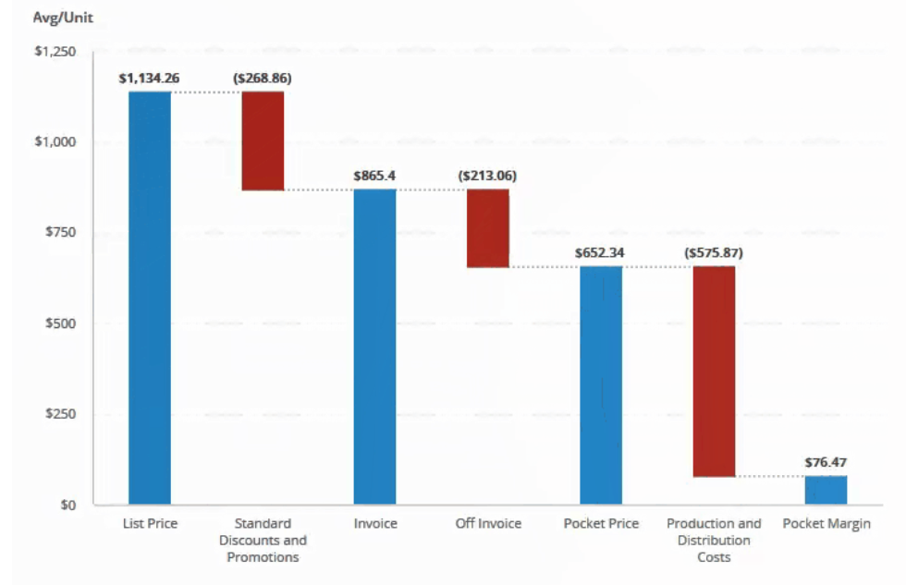
Level 7
PROS Report
Waterfall:
7. PROS Report
6. PROS Optimize
5. PROS Predict
4. PROS Protect
3. PROS Datacore
2. PROS Resilience
1. PROS Integrate

Slide 71


Level 8
PROS Modern UI
Modern UI:
Custom React component library (HTML5, JS, CSS), Angular, and open-source libraries such as Highcharts, Router, and Redux
8. PROS Modern UI
7. PROS Report
6. PROS Optimize
5. PROS Predict
4. PROS Protect
3. PROS Datacore
2. PROS Resilience
1. PROS Integrate

Slide 72


Level 9
PROS Products
Products:
Revenue Management
Offer Marketing
Pricing
Quoting
9. PROS Products
8. PROS Modern UI
7. PROS Report
6. PROS Optimize
5. PROS Predict
4. PROS Protect
3. PROS Datacore
2. PROS Resilience
1. PROS Integrate

Slide 73




Level 10
PROS Marketplace
10. PROS Marketplace
Marketplace:
Agreements
Subscriptions
Rebates
Constraint AI
9. PROS Products
8. PROS Modern UI
7. PROS Report
6. PROS Optimize
5. PROS Predict
4. PROS Protect
3. PROS Datacore
2. PROS Resilience
1. PROS Integrate

Slide 74
Notes:
So, let’s say goodbye to Copernicus

Slide 75
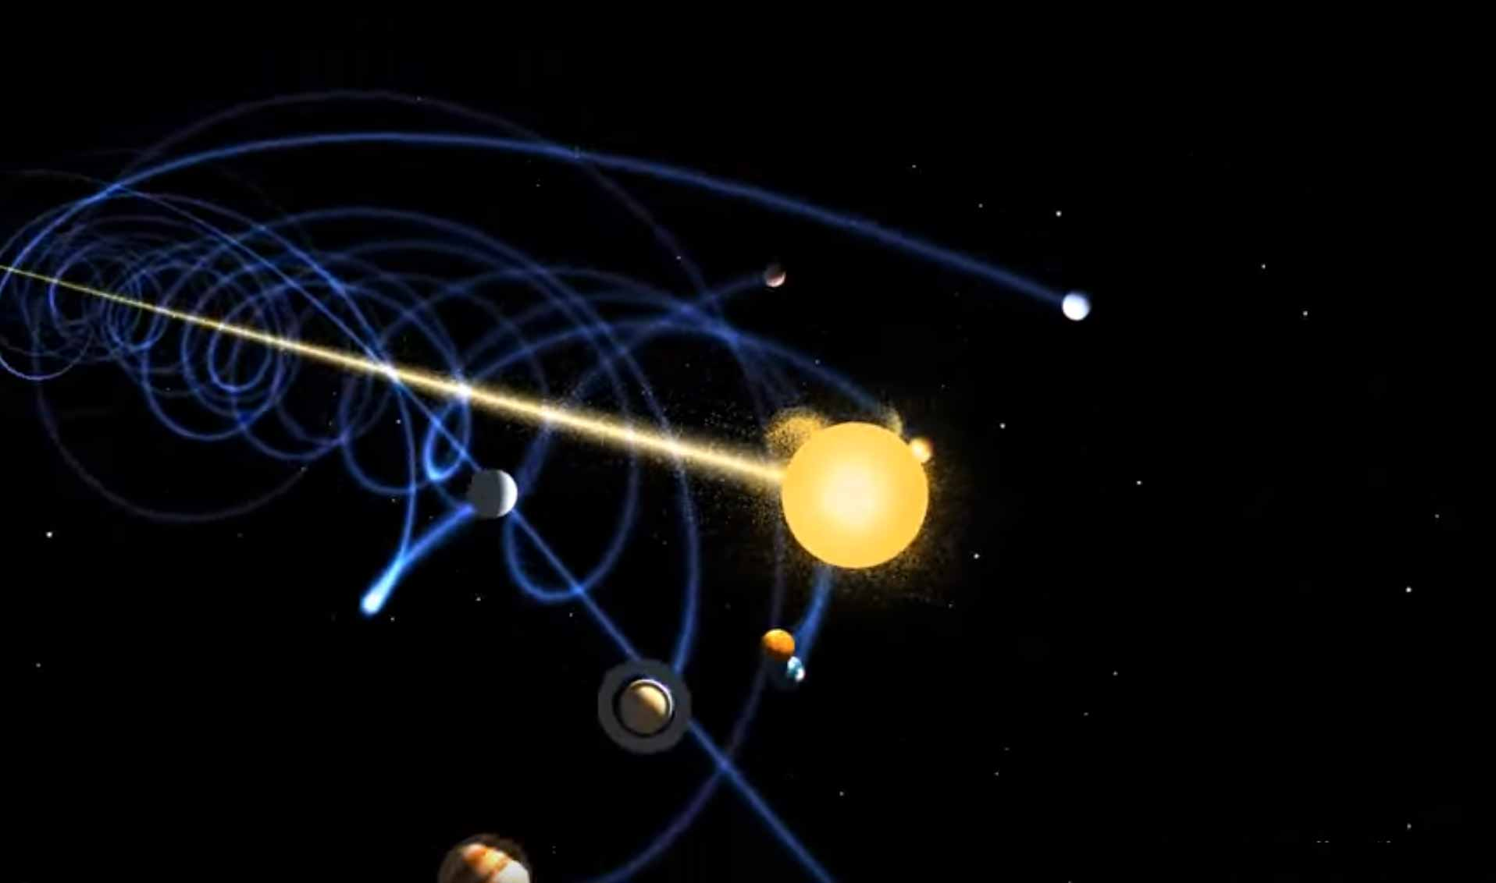

828,000 km/h
Notes:
The Solar System is traveling at an average speed of 828,000 km/h (230 km/s) or 514,000 mph (143 mi/s)

Slide 76


Slide 77


